Slide 1

Single Cycle RISCV Processor - Cache Memory Integration
Mostafa Masoud Ali
.. Alexandria University

Slide 2
OUTLINES
RISCV processor architecture .
Cache memory implementation .
System integration .

Slide 3
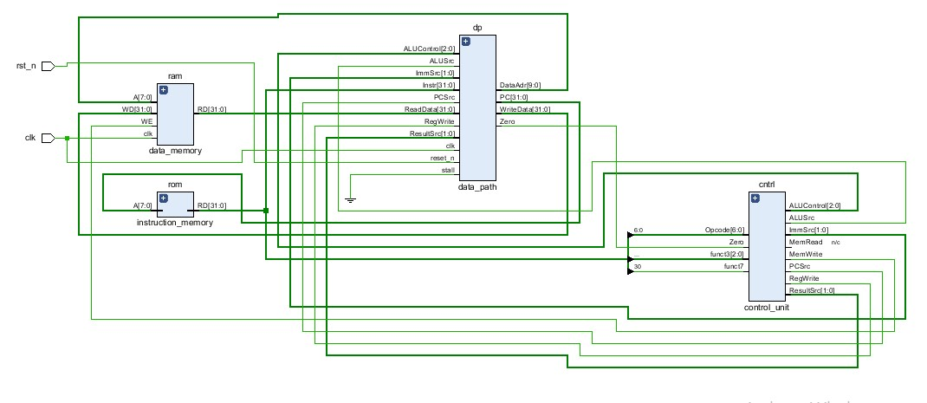
RISC-V Processor Architecture

Slide 4
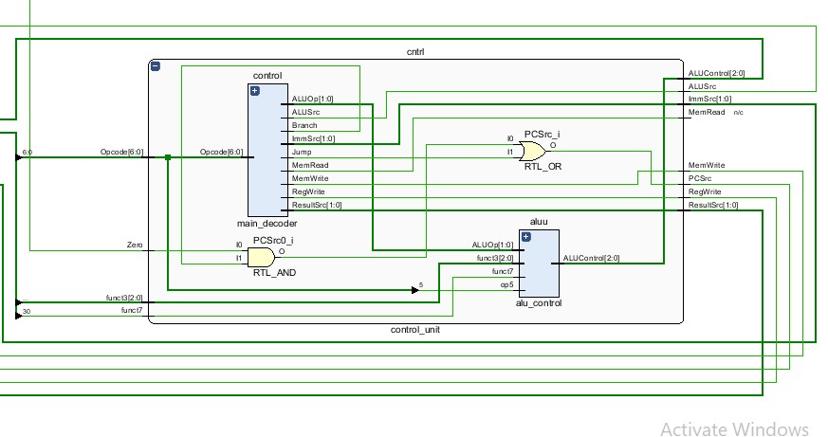
Control unit
Controls the whole blocks using multible control signals

Slide 5
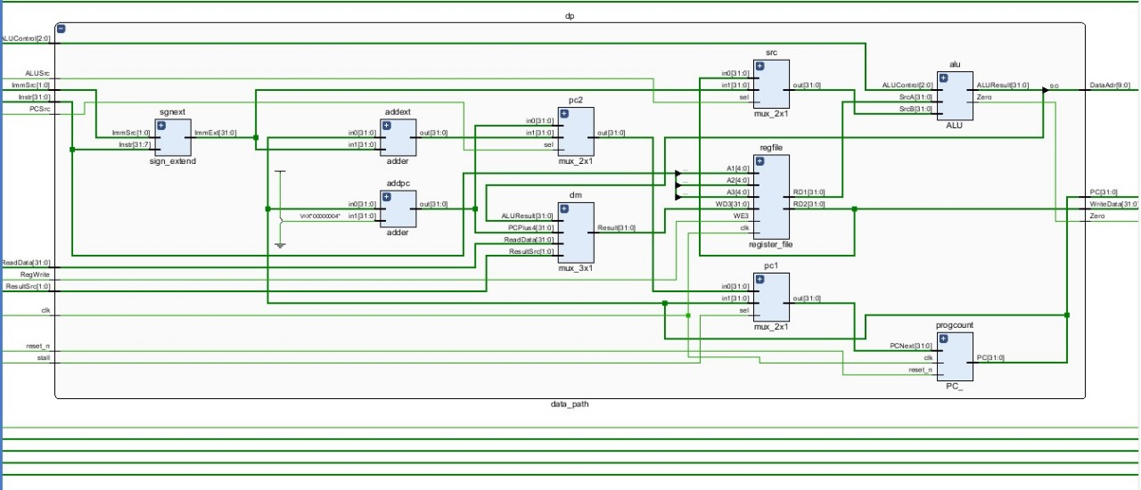
Datapath
Determines the flow of data in the processor

Slide 6
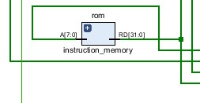
Instruction memory
A rom we store our executable program in.

Slide 7
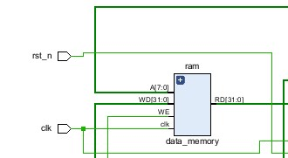
Data memory
The ram our processor uses to read and write data .

Slide 8
Instructions to be covered
a. R-Type: add, sub, and, or
b. I-Type: addi, andi, ori, lw
c. B-Type: beq, bne
d. J-Type: jal
e. S-Type: sw

Slide 9
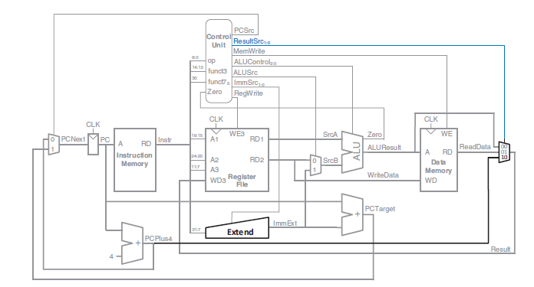

Slide 10
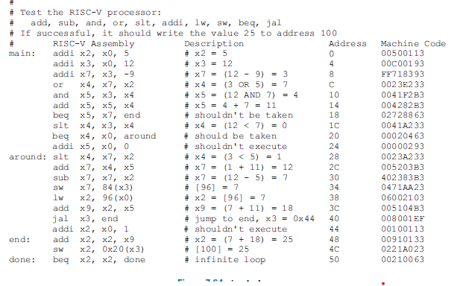
Sample assembly program

Slide 11
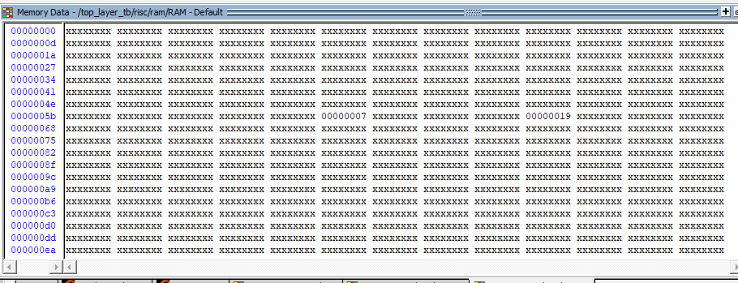
Output

Slide 12
Why cache ?
Cache memory

Slide 13
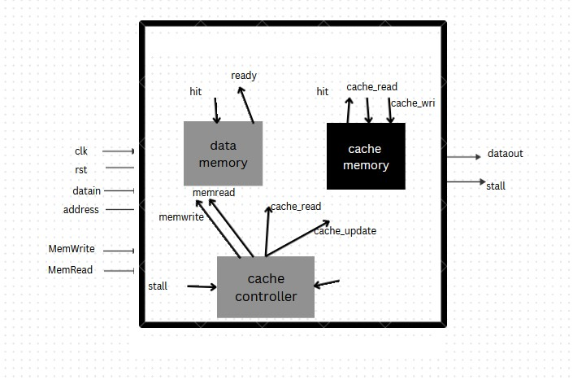

Slide 14
System Integration

Slide 15
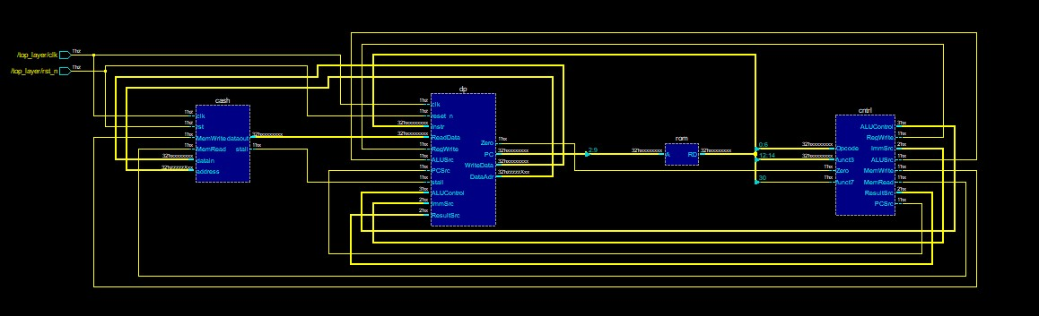

Slide 16
Modifications

Slide 17
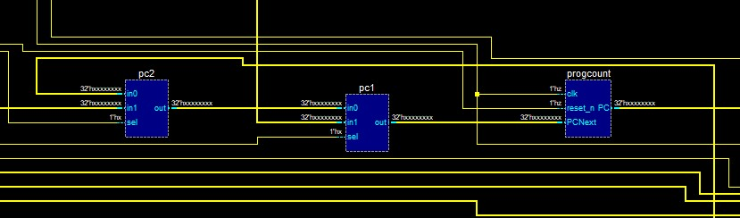
Cascaded muxes for program counter .

Slide 18
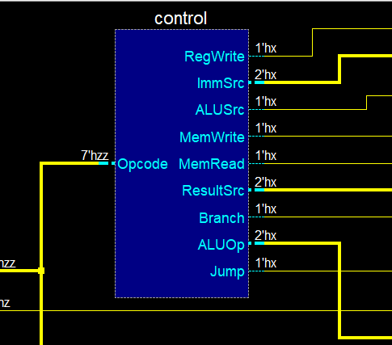
Extra control signal named MemRead .

Slide 19
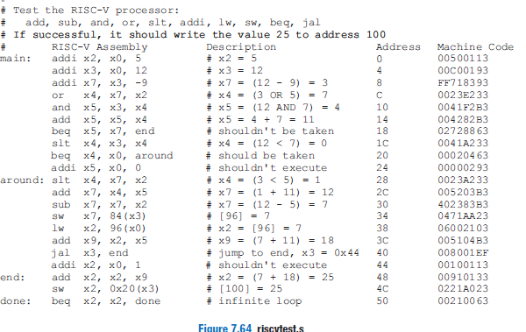
Remember me ?

Slide 20
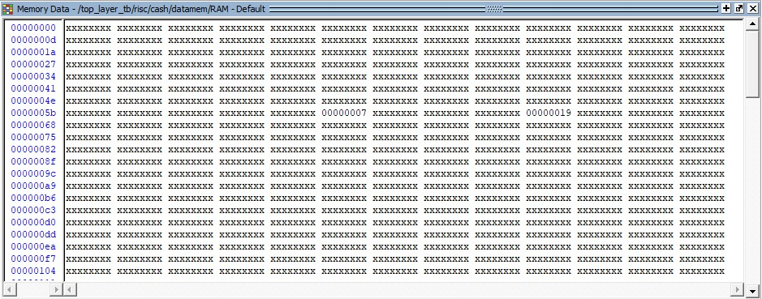
Data memory

Slide 21
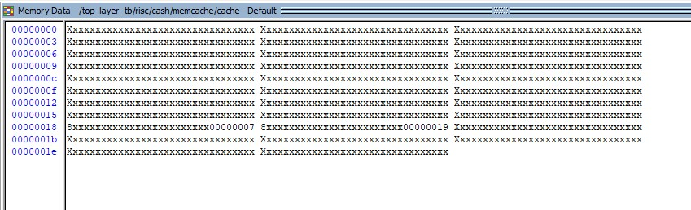
Cache memory

Slide 22
